Slide 1
Welcome!
Please type in chat:
What is one thing you hope to take away from today’s training?

Slide 2

Team Leadership
Carlos Osegueda
Acting DAS for Operations and Management
FHEO

Slide 3
Agenda
Roles and responsibilities
Key characteristics and competencies
Characteristics of a high performing team and troubleshooting team dysfunctions
Leadership
Notes:
Purpose: Better prepare you for current and future leadership roles

Slide 4
Supervisor vs. Team Leader
General Functions of Supervisors
General Functions of Team Leaders
Team Leaders are responsible to their supervisors or managers for assuring that the work of their assigned team is carried out by performing a range of coordinating and supportive duties and responsibilities. Team Leaders utilize a variety of coordinating, coaching, facilitating, consensus-building and planning techniques. These kinds of work methods and knowledges, skills and abilities (KSAs) are alternatives to traditional supervision which enable the team as a whole to deliver improved quality, quantity and timely services and/or work products to their customers.
Supervisors are accountable for planning, scheduling, and directing work operations, administering supervisory personnel functions, evaluating work performance, and taking necessary action to assure that the work of subordinate employees meets standards of quantity and quality.
Source: OPM General Schedule Leader Grade Evaluation Guide (June 1998)
Notes:
• As the Lead having a clear understanding of the role between the Supervisor/Manager and the Lead responsibilities and ensuring that you fully understand that
boundary.
• Ensuring a clear understanding of the Supervisor/Manager’s goals and ensure that you as the Lead are following the intent. This includes frequent check-ins with the
Manager to ensure you’re on track.
As a regular and recurring part of their job and at least 25% of their duty time, to lead a team of other GS employees in accomplishing two-grade interval work. Team leaders usually participate in the work of the team by performing work that is of the same kind and level as the highest level of work accomplished by the team being led.
Functions include:
▪ Ensuring the organization’s strategic plan, mission, vision and values are communicated to the team and integrated into the team’s strategies, goals, objectives, work plans, products and services;
▪ Communicating to the team the assignment, project, problem to be solved, actionable events, milestones and deadlines;
▪ Coaching the team in the selection and application of problem solving and work methods, practices and procedures, and assisting with solutions;
▪ Leading the team in distributing and balancing workload among employees in accordance with work flow, skill level and/or work specialization; making adjustments to accomplish the workload in accordance with priorities;
▪ Articulating and communicating to the team the assignment, project, problem to be solved, actionable events, milestones and deadlines and time frames.

Slide 5
Region IV GS-13 Team Lead Roles and Responsibilities
1. Coaching/Mentoring
2. Leading Compliance Reviews
3. Government Technical Representative
5. Quality Assurance and Quality Control Activities
6. Performance input on less senior staff to the supervisor
7. Training
8. Special Projects
9. Leadership
4. Consistently assigned novel and complex work within the employee’s assigned portfolio

Slide 6
Characteristics of a Successful Team Lead
Clear Communicator
Example of Integrity
Influential in Core Areas
Powerful Facilitator and Skilled Negotiator
Fair-Minded
Respectful to Others
Strong Organizational Skills
Confident in the Team and Themselves
Courageous
Agile/Flexible
Notes:
A Clear Communicator
Effective team leaders communicate clearly. Quality verbal and written communication skills allow leaders to present expectations to team members in a way workers can understand. Effective communication skills also allow team leaders to listen to the input of others.
2. Strong Organization Skills
Effective team leaders possess exceptional organizational skills. Organizational skills help team leaders plan objectives and strategies, which allow team members to perform optimally. Organized team leaders put systems in place that maintain order and guide team members toward meeting company goals and objectives.
3. Confident in the Team
An effective team leader is confident in his abilities, as well as confident in the abilities of his team members. A confident leader is secure in the decisions he makes that affect his team. A self-confident team leader also reassures team members of his authority within the organization.
4. Respectful to Others
A quality team leader is respectful of his team members. A respectful leader empowers employees by encouraging them to offer ideas about decisions that affect them. This lets team members know that the leader respects their input and opinions.
5. Fair and Kind
A quality team leader treats team members fairly. He is consistent with rewards and recognition, as well as disciplinary action. A fair leader ensures all employees receive the same treatment.
6. An Example of Integrity
An effective team leader is honest and open with his team members. Leaders who possess integrity gain the trust of team members because he does what he says he will do and treats others the same way he wants to be treated.
7. Influential in Core Areas
Influential leaders help inspire the commitment of team members to meet company goals and objectives. Influential leaders also help manage change in the workplace by gaining the confidence of workers through effective decision making and communication.
8. Willing to Delegate
Effective team leaders know how to share leadership through delegation. Delegating certain tasks to trustworthy team members allows the leader to focus on improving workplace functions and production.
9. Powerful Facilitator
Effective team leaders are powerful facilitators. As a facilitator, team leaders help workers understand their goals. They also help organize an action plan to ensure team members meet their goals and objectives more efficiently.
10. A Skilled Negotiator
Team leaders utilize negotiation skills to achieve results and reach an understanding in the event of a workplace conflict. Team leaders who negotiate effectively streamline the decision-making process, as well as solve problems for the best interest of everyone involved.

Slide 7

Credibility = Competency + Trust
13 Behaviors of High Trust Leaders
Notes:
Establishing credibility with the Team early. This is important so that the Team can see the Lead as an asset and not an obstacle.

Slide 8
Knowledge Check
Only supervisors can give employees performance feedback. True or False
An Equal Opportunity Specialist, GS-13, can review the work of other Equal Opportunity Specialists if empowered to do so by their supervisor. True or False
A subordinate’s supervisor is the only one that can rate their performance through the Employee Performance Planning and Evaluation System (EPPES). True or False
Only a supervisor can be a leader. True or False
When must the supervisor be involved with performance feedback?

Slide 9
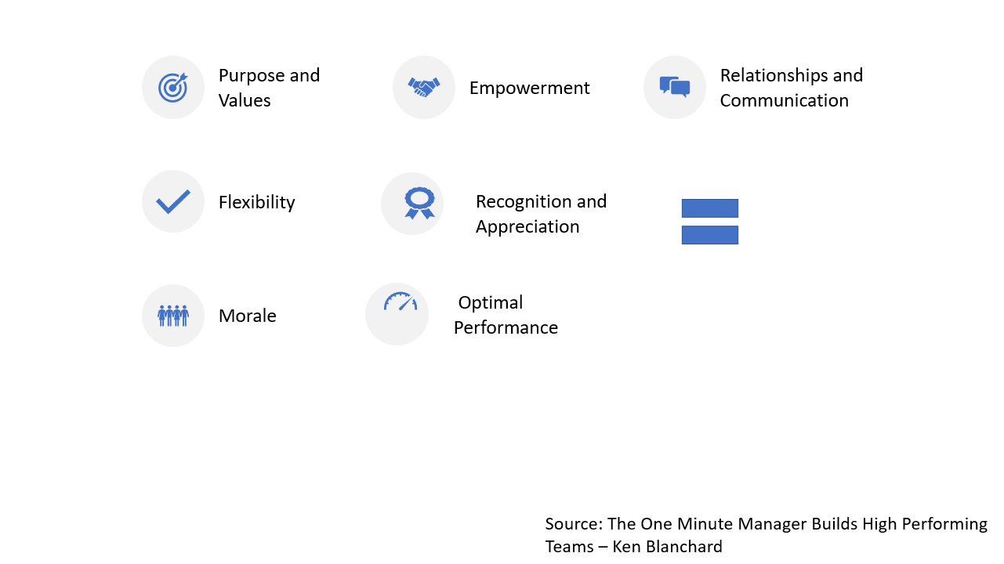
Notes:
PERFORM
Each characteristic is critical and serves a different functions
An effective team starts with a clear purpose and a set of values. The hoped for end results are optimal productivity and good morale. The means to the ends are empowerment, relationships and communication, flexibility and recognition and reward.

Slide 10
Characteristics of a High Performing Team
Purpose and Values
The team has a clear commitment to a common purpose. Team members know what the team’s work is and why it is important.
Shared values and norms promote integrity, quality, and collaboration.
Individual roles are clear, and their relationship to the team purpose and goals is understood.
Relationships and Communication
Different ideas, opinions, feelings, and perspectives from all team members are encouraged and considered.
The team uses effective methods for finding common ground and managing conflict.
Honest and open feedback helps team members be aware of their strengths and weaknesses.

Slide 11
Characteristics of a High Performing Team
Empowerment
Values norms and practices encourage initiative, involvement and creativity.
Team has access to relevant information.
Direction, structure and training are available to support individual and team development.
Flexibility
The team can meet challenges using the unique talents and strengths of all team members.
The team is open to exploring different ways of doing things and adapts to change.
Calculated risks are supported. Mistakes are seen as opportunities for learning.

Slide 12
Characteristics of a High Performing Team
Optimal Productivity
The team consistently produces significant results; the job gets done.
The team is committed to high standards and measures for goal accomplishment.
The team is using effective problem-solving and decision-making practices to achieve goals.
Morale
Team members are confident and enthusiastic about their work.
Team members trust, support, and help one another.
Team encourages hard work, as well as having fun.
Notes:
I know what I must do, and the team’s goals are clear.
Everyone takes some responsibility for leadership.
There is active participation by everyone.
I feel appreciated and supported by others.
Team members listen when I speak.
Different opinions are respected.
We enjoy working together and we have fun.

Slide 13
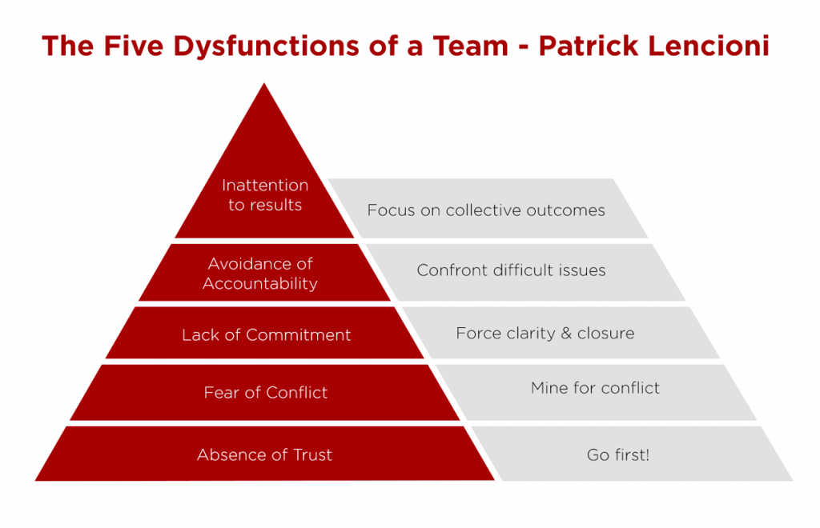
Lencioni’s 5 Dysfunctions of a Team
Notes:
Focus on a cohesive leadership team on results
Trust
Without trust you cannot build a team. Trust is the foundation.
Conflict
You cannot engage in successful conflict without trust. With trust you have the pursuit of truth and what’s best for the team which will drive healthy conflict.
Commitment
Without conflict, commitment falters. Without open and honest conflict, don’t really commitment to the decisions made. Everyone weighs in and commits to decisions.
Accountability
Most common. When committed more likely to hold each other accountable.
Results
Everything below on the pyramid must be working properly.

Slide 14
Test Your Understanding #1
You are an EOS, GS-13, in a branch that has recently increased in size from five to seven. Your supervisor frequently bounces ideas off you because you are the senior EOS on the team. Your supervisor has asked for your input as to how to operationalize the team.
The original five are all journeyman level specialists that worked well together. You just added a recent MBA named Jason who is constantly making suggestions on how to fix the operation and is not buckling down to learn his job. In fact, he is diverting his focus because he doesn’t understand the work and he’s struggling to learn basic investigative techniques.
Shari is the other challenge for your supervisor. She just completed law school and is overworking her intake analysis by conducting a preliminary investigation at the intake stage. She also refuses to conduct an investigative plan and as a result is over-investigating her cases and falling behind on her work.
Your supervisor, Anita Jones, is a new supervisor and has come to you because she is desperate for you to help her with the challenges the new hires are bringing her. All she wants right now are intake conversions in 30 days and to decrease her aged case rate to 10%.
Develop your talking points and actions items for your meeting with Ms. Jones.
Notes:
45 Minutes
Everything should be viewed as an opportunity.
Criticism of the supervisor from a colleague
Feedback to colleagues
Filling void of supervisors
Knowing when to involve the supervisor
How to handle dysfunction out of your control without letting it consume you
Onboarding

Slide 15
Test Your Understanding #1
How would you incorporate characteristics of a high performing team and what you learned from the 5 Dysfunctions of a Team to help Anita?
What opportunities can be exploited when new staff onboard?
Give some examples of how to best utilize the original five employees.
What suggestions do you have concerning Jason, his focus, and his difficulties grasping the basic investigative techniques?
What’s the plan for training Sara?
Provide tangible strategies and goals surrounding the aged case backlog.
What’s your advice for Anita and where her time should be spent?
Notes:
Role-Play

Slide 16
Good morning!
Please type in chat:
Share a time when you worked with a colleague, supervisor or manager who gave good feedback. Why was it effective?

Slide 17
7 Keys to Effective Feedback
Goal-Referenced – Feedback leads to a goal
Tangible and Transparent – Feedback should be so tangible that anyone can learn from it, and desired results should be clear
Actionable – Effective feedback is concrete, specific, and useful
User-Friendly – Effective feedback should be geared towards the level of person you are giving the feedback to
Timely – Feedback should be provided as quickly as possible
Ongoing – The more feedback someone gets, the more they improve
Consistent – Feedback needs to be stable, accurate, and trustworthy
7 Keys to Effective Feedback – Grant Wiggins
Notes:
Wiggins teaches teachers. Wiggins’ article is written with teachers in mind, but has its place in the work environment, especially with developmental plans.
According to Wiggins, feedback is not advice, praise, criticism, or evaluation
Goal Orientated –Effective feedback requires that a person has a goal, takes action to achieve the goal, and receives goal-related information about his or her actions. Information becomes feedback if, and only if, I am trying to cause something, and the information tells me whether I am on track or need to change course. If some joke or aspect of my writing isn't working—a revealing, nonjudgmental phrase—I need to know.
Tangible & Transparent – A good feedback system involves not only a clear goal, but also tangible results related to the goal.
Actionable – The receiver of the feedback should know what to do with it because it provides actionable information.
User-Friendly – The person receiving the feedback should leave with one important takeaway or a few takeaways rather than several things that may become overwhelming.
Timely –The longer you wait, the less useful it becomes.
Ongoing –It is a formative process. - The Formative Assessment Process is a deliberate process used by teachers and students during instruction that provides actionable feedback that is used to adjust ongoing teaching and learning strategies to improve students' attainment of curricular learning targets/goals.
Consistent – Feedback needs to be stable, accurate, and trustworthy.

Slide 18
Positive Feedback Opportunities
When an employee meets or exceeds goals
When an employee models a behavior that you want repeated
When an employee helps colleagues or customers with something time consuming or significant
When an employee overcomes an obstacle
When an employee takes initiative
When an employee needs a confidence boost
When an employee goes an extra mile
Notes:
Studies have shown that the ratio of positive feedback can be as high as 6:1 on high performing teams.
Managers tend to take positive performance for granted or provide non-specific positive feedback
According to Gallop Research positive feedback can: Improve employee engagement, Lower turnover rate and Improve Productivity
1. Genuine
Don’t praise your employees just for the sake of it. People will see straight through you and your whole relationship will be ruined. Give positive feedback to your employees when you have a concrete reason. Be direct and honest.
2. Timely
Make sure that your feedback is timely, given in-the-moment. Don’t wait for a scheduled meeting or a performance review to give your employees positive feedback. Waiting to recognize your employees can leave them feeling as though their hard work has gone unnoticed.
3. Specific
Gallup has found that employees are more likely to learn and grow when they receive immediate feedback that is specific. Avoid giving vague praise and say exactly what your employee did that you find commendable. Your feedback should be crystal clear and to the point.
5. Framed in a bigger context
If you want to make your feedback more impactful and powerful, frame your employees’ accomplishments in a bigger context. Explain the impact of their achievement on others (colleagues and customers) and link it to your company’s bottom line.
8. Personalized
Tailor your positive feedback to each of your employees. For example, some employees feel great when they’re recognized in the public, while the other might prefer receiving positive feedback privately. Get to know your employees and their preferences!

Slide 19
SBI Model
1. Specific
Describe the situation with specifics
2. Behavior
Describe the behavior observed (rather than motivation)
3. Impact
Describe the impact the behavior had

Slide 20
How to Give Feedback Effectively
1. The Micro Yes
2. Data Point
3. Impact Statement
4. A Question
Notes:
Micro Yes
“I have some ideas how we can improve our efficiency. May I share them with you?” It let’s the person know you are about to give feedback and allows buy-in.
Data Point – most difficult dependent upon the employee’s response.
Be specific. With positive and constructive feedback.
Impact Statement
Because you missed the deadline, I could not ___
A question
This is what I think, what’s perspective?
Pull Feedback
Soliciting feedback

Slide 21
Dealing with Feedback Reactions
Why do people respond defensively to feedback?
Notes:
They feel threatened

Slide 22
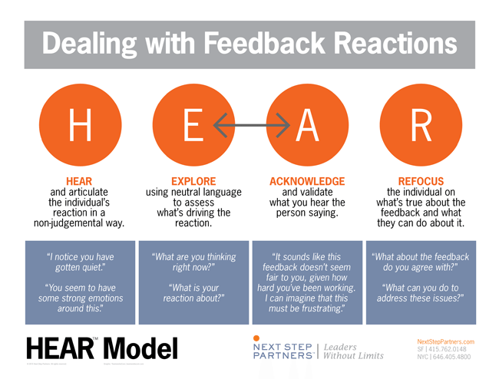

Slide 23
Test Your Understanding #2
You are a high performing EOS GS-13 in a Programs and Compliance Branch. You have been operating as a leader in your branch for the past two years due to the surge in hiring. Specifically, you have been coaching new hires, providing formal training, and reviewing the new hires’ work before it goes to the supervisor.
Your colleague, Suzy Whiner, EOS, GS-13, is in Enforcement, and her supervisor has asked her to perform similar duties and responsibilities as you given the two recently hired GS-09’s in her branch. Ms. Whiner has approached you complaining that she does not think it is fair that she is assigned extra work, because she is the best producer on the team and the extra duties will slow her down. Ms. Whiner is always complaining about all the extra cases she has, but it is only a couple more cases more than her colleagues at lower grades.
You and Ms. Whiner came on at the same time and are both regarded as highly competent. Unfortunately, Ms. Whiner’s negative attitude at times has been off-putting to some of the new employees.
Develop some talking points and advice in preparation for your conversation with your friend and colleague, Ms. Whiner.
Notes:
Leaders are part of the solution not part of the problem.
Get used to separating personal from business. You will have to do it for your next promotion.
Criticism of the supervisor from a colleague
Feedback to colleagues
Filling void of supervisors
Knowing when to involve the supervisor
How to handle dysfunction out of your control without letting it consume you
Onboarding

Slide 24
Test Your Understanding #2
Are you the right person to have this conversation? If so, why?
Is there anyone that you should consult with prior to talking with Ms. Whiner?
Are Ms. Whiner’s new duties fair? Does it matter?
How would you specifically address Ms. Whiner’s perceived unfairness?
Is it possible that Ms. Whiner may have too much work? If she does have too much work, what would tell Ms. Whiner to do?
How would you incorporate Ms. Whiner’s expertise in the consultation?
Would you address Ms. Whiner’s negative attitude? Assume that you agree that she has a negative attitude. If yes, what would you tell her? If no, what would you do, if anything, about the negative attitude?

Slide 25
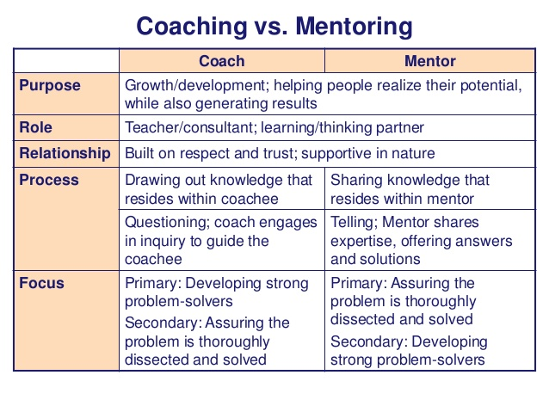
Coaching vs. Mentoring
Notes:
A business coach focuses on specific skills and development goals by breaking them into concrete tasks to be completed within a specified period of time. By doing so, business coaches help and guide businesses clarify their growth vision.
For many businesses, identifying and prioritizing goals is a big challenge. Business coaches address this challenge by helping businesses prioritize their goals on the basis of importance. They follow a more formal, structured approach to resolve issues and manage specific aspects of the job.
A mentor, in simple words, is someone who offers their knowledge, expertise and advice to those with less experience. By leveraging their experience and skills, mentors guide mentees in the right direction.
A mentor helps mentees consider opportunities for career growth, gain confidence and improve interpersonal skills. The support is based on the mentor’s own experiences and learnings, which makes them more reliable figures in the eyes of the mentees.

Slide 26
GROW Coaching Model
Goal
What do you want?
Reality
Where are you now?
Options
What could you do?
Will Do
What will you do?
Notes:
Developed by Executive Coach in the 1980s (John Whitmore ). Empowering someone to solve their own problems by asking powerful questions.
Goal – What are you trying to achieve
Tell me about the problem?
What does the situation look like when it resolved?
Reality – What’s really going on at the moment. Most of the coaching happens at this stage
What are you experiencing
Tell me more about what you have already tried
What obstacles are in your way
Options – Coach helps with the brainstorming
What are your options
What could you do to move yourself one step forward
What would you do if you knew you knew you could not fail
Will – What will you do – positive action
What are your next steps
What will you do and by when - write it down
What support do you need and from whom

Slide 27
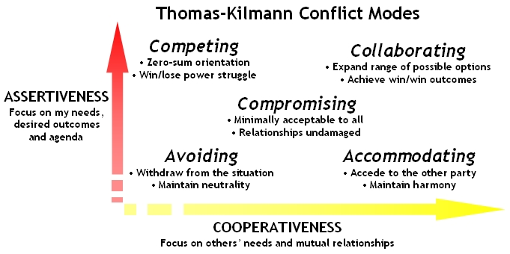

Slide 28
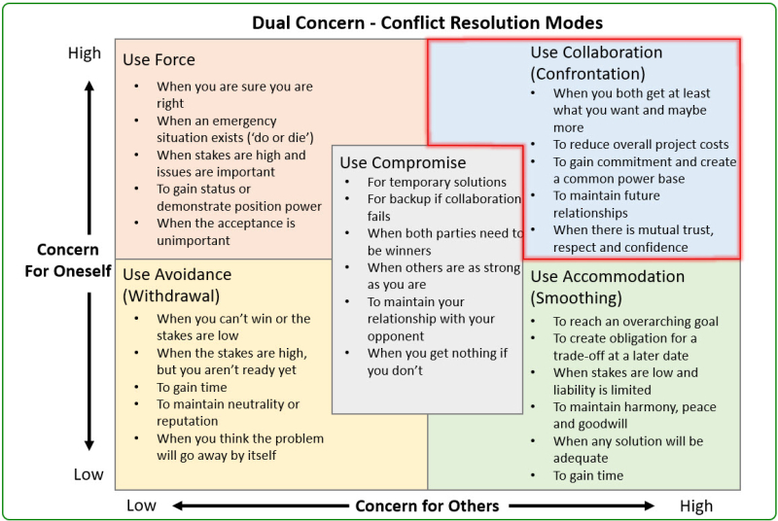

Slide 29

Knowledge Check
When is it acceptable to avoid conflict?
Under what circumstances is the competing mode of conflict the best option?
Are there any potentially negative consequences handling conflict by way of collaboration?
What is the down-side of the accommodating mode?
How do you regroup/reestablish after a particularly robust debate?
Notes:
Special Project Team
Conflict with a supervisor’s direction

Slide 30
Test Your Understanding #3
Allison Payne is your supervisor. Ms. Payne has just rated you marginally successful on the timeliness of your investigations because you have too many aged cases. You are very upset because you were expecting an outstanding because you have been helping to train and coach new staff. You have also been assisting with quality control by reviewing cases from time to time for your supervisor and acting when your supervisor is out. You were promoted this FY to the EOS, GS-13, and have never received less than Outstanding.
Reflect on the scenario and outline your next steps moving forward.
Notes:
Know you EPPES.
Results is your scorecard.

Slide 31
Test Your Understanding #3
What are your options with a performance rating you don’t agree with?
How do you handle too many responsibilities?
How do you address frequent responsibilities not in your performance plan that draw you away from requirements in your EPPES?
What will you ask of Allison?

Slide 32
You made it!
How do you define leadership?

Slide 33
Leadership
Leadership is not:
Leadership is not management
A title or position
Hierarchy in the organization
Personal attributes
Sources: What is Leadership – Kevin Kruse

Slide 34
Leadership
“Leadership is process of social influence, which maximizes the efforts of others, towards the achievement of a goal.”
“A great leader’s unique achievement is a human and social one which stems from his understanding of his fellow workers.”
“A successful leader as one who can understand people’s motivations and enlist employee participation in a way that marries individual needs and interests to the group’s purpose.”
Sources: What is Leadership – Kevin Kruse & Understanding Leadership – W.C.H. Prentice

Slide 35
Leadership
Give them the freedom to use their talents.
Guide them to work together toward a compelling vision.
Show up as the leader and develop leaders within.
Give them what they need to be successful.
Create an environment where people want to be.
Model accountability and teach responsibility.
Be decisive and purposeful.
Don't underestimate the power of EQ
Teach them that everything is hard before it's easy.
Give them something to learn and grow on.
Show them fearlessness and encourage them to be brave.
Earn their respect and give them yours.
Admit that you don't have all the answers.
Create win-win situations.
Be agile and flexible.
Build your relationships
Be accessible and available
Consistently praise them and always appreciate them.
Source: 20 Powerful Ways to Lead Your Team to Greatness – Lolly Daskal
Notes:
A great leader’s unique achievement is a human and social one which stems from his understanding of his fellow workers.
a successful leader as one who can understand people’s motivations and enlist employee participation in a way that marries individual needs and interests to the group’s purpose.

Slide 36
Leadership Styles
“Leaders who have mastered four or more, especially the
authoritative, democratic, affiliative, and coaching styles –
have the best climate of business performance.”
Source:
Harvard Business Review Onpoint – Executive Edition
Leadership That Gets Results

Slide 37
Leadership Styles
 | Coercive | Authoritative | Affiliative | Democratic | Pacesetting | Coaching
The leader’s modus operandi | Demands immediate compliance | Mobilizes people toward a vision | Creates harmony and builds emotional bonds | Forges consensus through participation | Sets high standards for performance | Develops people for the future
The style in a phrase | “Do What I tell you.” | “Come with me.” | “People come first.” | “What do you think.” | “Do as I do now.” | “Try this.”
Underlying competencies | Drive to achieve, initiative, self-control | Self-confidence, empathy, change catalyst | Empathy, building relationships, communication | Collaborative, team leadership, communication | Conscientiousness, drive to achieve, initiative | Developing others, empathy, self-awareness
When the style works best | In a crisis, to kick start a turnaround, or with problem employees | When changes require a new vision, or when a clear direction is needed | To heal rifts in a team or to motivate people during stressful circumstances | To build buy-in or consensus, or to get input from valuable employees | To get quick results from a highly motivated and competent team | To help an employee improve performance or develop long term strengths
Overall impact on climate | Negative | Most strongly positive | Positive | Positive | Negative | Positive

Slide 38
Getting to Yes
Try on their point of view
Invent win-win agreements
Insist on using objective criteria

Slide 39
Harvard Principles of Negotiation
Separate the person from the issue
1
Negotiate interest orientated
2
Develop good criteria that a good solution must fulfill
3
Develop several options
4

Slide 40
Oz Principle
Above the Line
Do it
Below the Line
Not Enough Resources
Solve it
Own it
See it
Ignore it
Confusion – tell me what to do
Deny it
Wait and see
Not my job
Cover up
Notes:
As the Lead make sure your communications and efforts are following the OZ Principle (above the line).
Above the line questions:
What’s in the best interest of the mission, team, and then the individual
Will my decision placate or solve the problem
What else can I do
What aspects of this situation will pull us below the line in the future
If we really owned it, what would we do differently
What can we control and what can’t we control in the situation
Don’t do what’s easiest, do what’s best to solve the problem.
Holding people accountable: define desired result- determine time to report on progress- deliver praise or coaching

Slide 41
Accountability Decision Making Questions
What’s in the best interest of the mission?
What’s in the best interest of the team?
Will my decision placate or solve the problem?
If we really owned it, what would we do differently?
What aspects of this situation will pull us below the line in the future?
Am I thinking above the line or below the line?
What can I control and what can’t I control in the situation?
Notes:
Be Cool
Don’t do what’s easiest, do what’s best to solve the problem.

Slide 42
Knowledge Check
“I don’t have time” is an above the line comment? True of False
Considering the impact on the mission and team is appropriate before making a recommendation on an individual’s request? True or False
What principles do Getting to Yes and the Harvard negotiation model have in common?

Slide 43
21 Irrefutable Laws of Leadership
1. The Law of the Lid
-Leadership Ability Determines a Person’s Level of Effectiveness
2. The Law of Influence
-The True Measure of Leadership Is Influence – Nothing More Nothing Less
3. The Law of Process
-Leadership Develops Daily, Not in a Day
4. The Law of Navigation
-Anyone Can Steer the Ship, but It Takes a Leader to Chart the Course
5. The Law of Addition
-Leaders Add Value by Serving Others
6. The Law of Solid Ground
-Trust Is the Foundation of Leadership
7. The Law of Respect
-People Naturally Follow Leaders Stronger Than Themselves
8. The Law of Intuition
-Leaders Evaluate Everything with a Leadership Bias
9. The Law of Magnetism
-Who You Are Is Who You Attract
10. The Law of Connection
-Leaders Touch a Heart Before They Ask for a Hand

Slide 44
21 Irrefutable Laws of Leadership
11. The Law of Inner Circle
-A Leader’s Potential Is Determined by Those Closest to Him
12. The Law of Empowerment
-Only Secure Leaders Give Powers to Others
13. The Law of the Picture
-People Do What People See
14. The Law of Buy-In
-People Buy into the Leader, Then the Vision
15. The Law of Victory
-Leaders Find a Way for the Team to Win
16. The Law of the Big Mo
-Momentum Is a Leader’s Best Friend
17. The Law of Priorities
-Leaders Understand That Activity Is Not Necessarily Accomplishment
18. The Law of Sacrifice
-A Leader Must Give Up to Go Up
19. The Law of Timing
-When to Lead Is As Important As What to Do and Where to Go
20. The Law of Explosive Growth
-To Add Growth, Lead Followers – To Multiply Lead Leaders
21. The Law of Legacy
-A Leader’s Lasting Value Is Measured by Succession

Slide 45
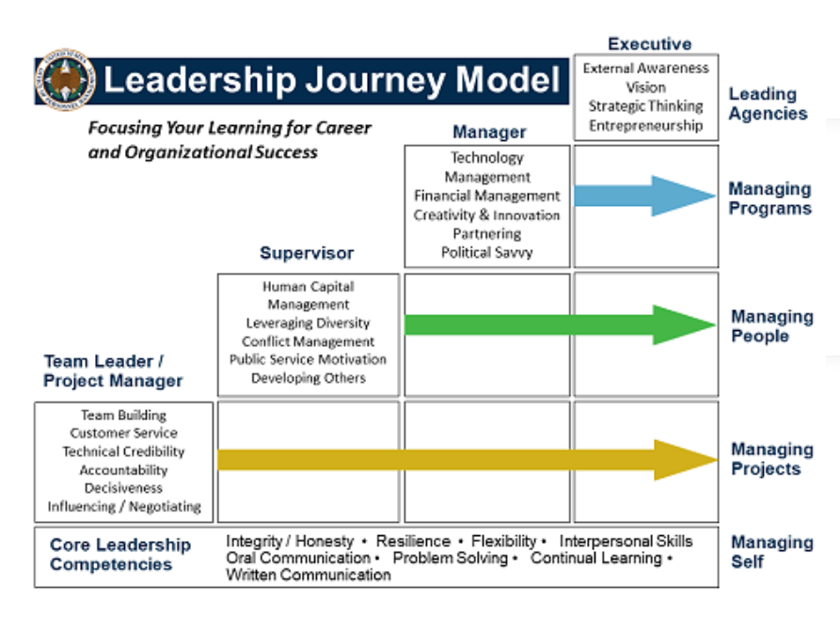

Slide 46
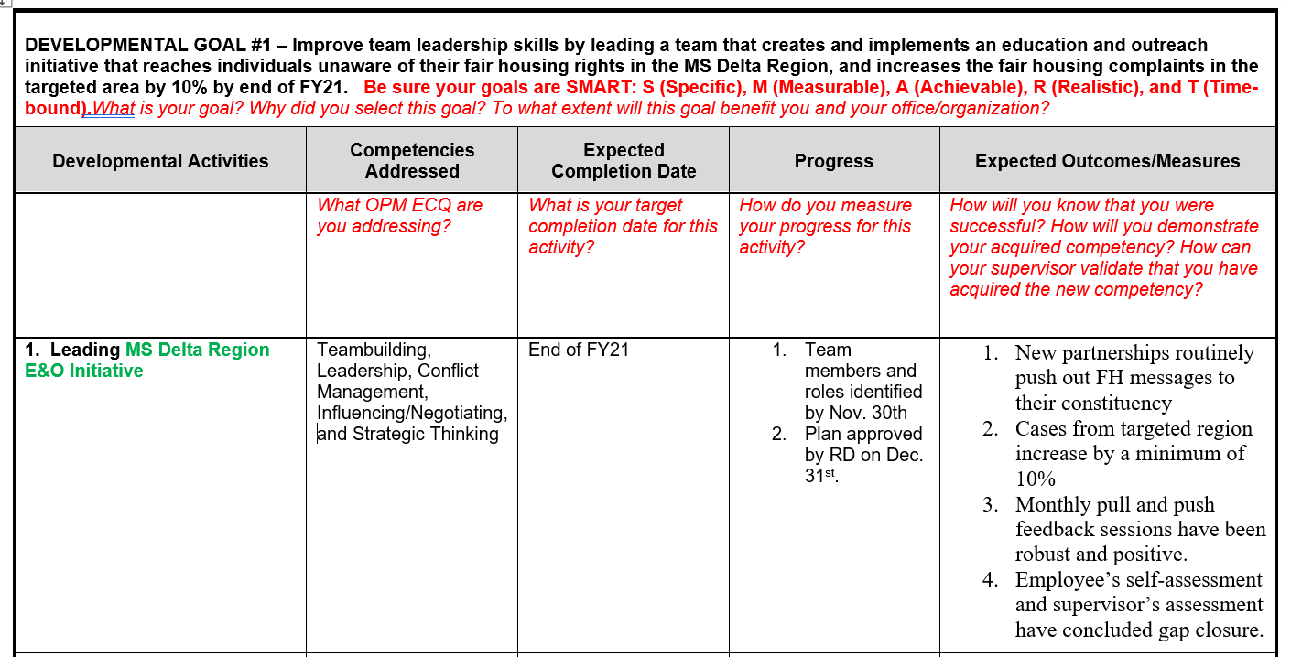
LDP Template

Slide 47
Q&A

Slide 48
Resources
In addition to the live links throughout this slide deck, here are some additional resources:
HUD Individual Development Plan
International Coaching Federation Core Competencies

